Slide 1
Special Topics in
AI
PART 7
Business Intelligence
Prof. Ahmed Sultan Al-Hegami
Professor of AI & Intelligent Systems
Sana’a University

Slide 2
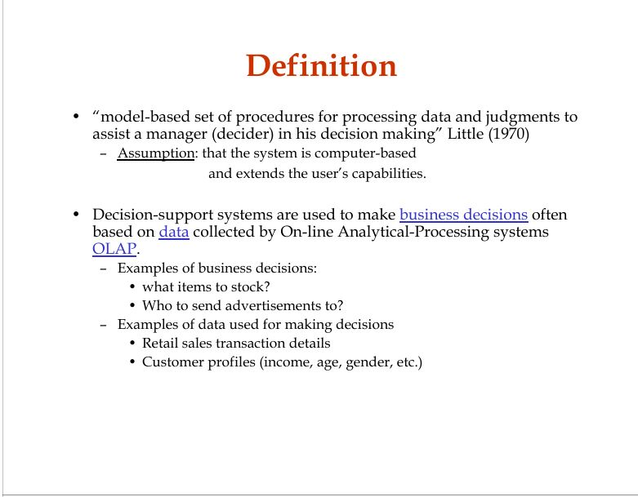

Slide 3
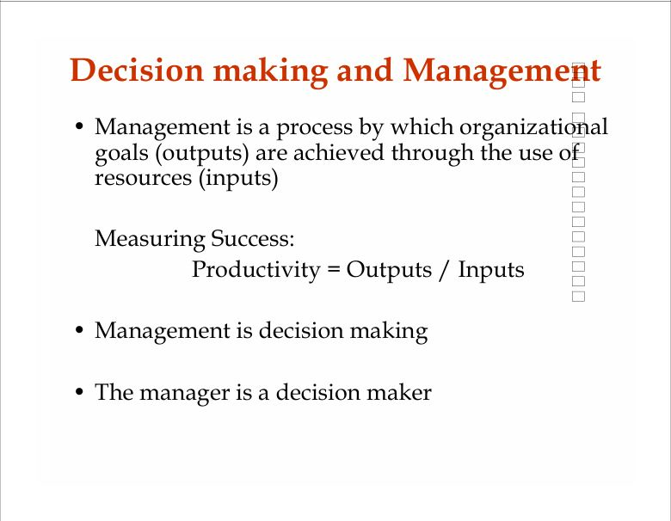

Slide 4
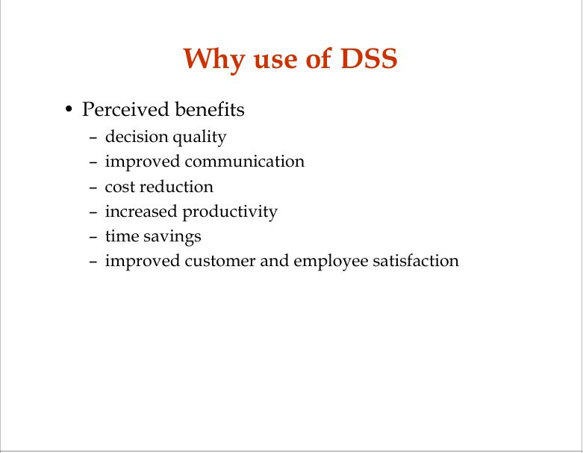

Slide 5
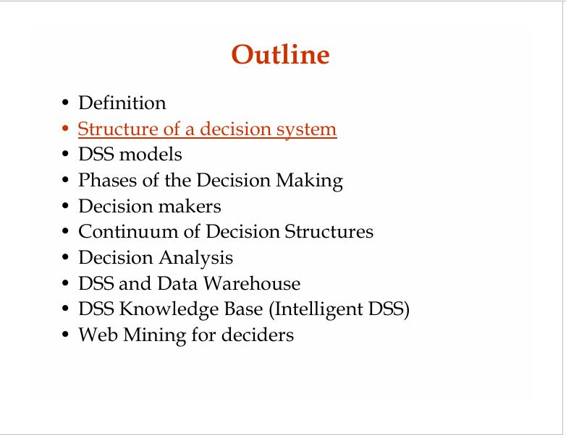

Slide 6
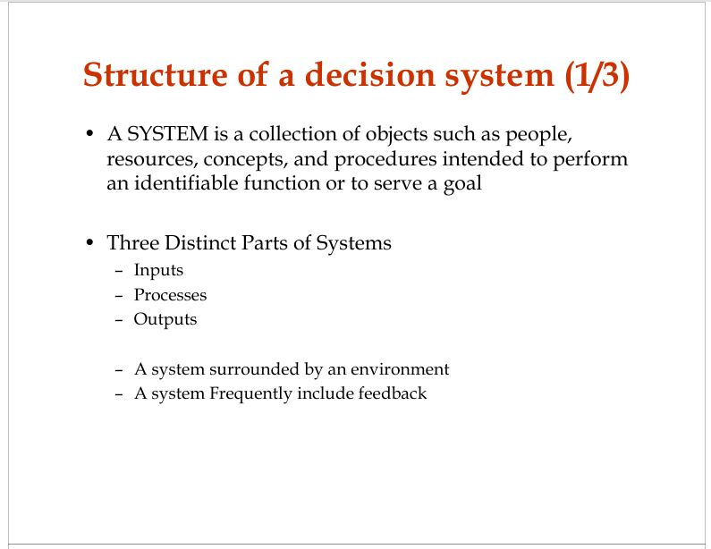

Slide 7
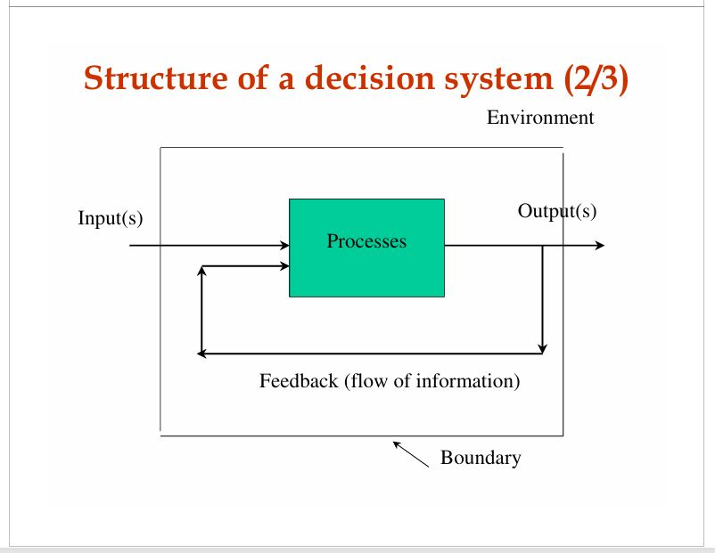

Slide 8
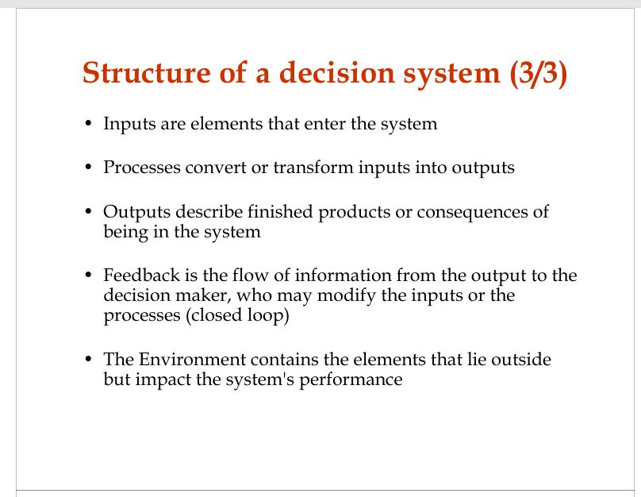

Slide 9
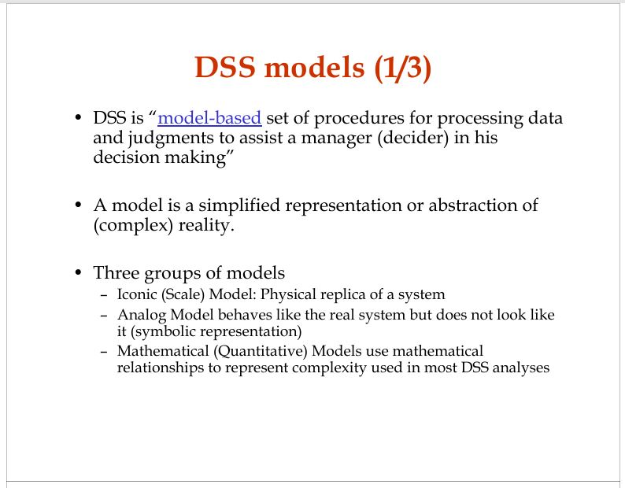

Slide 10
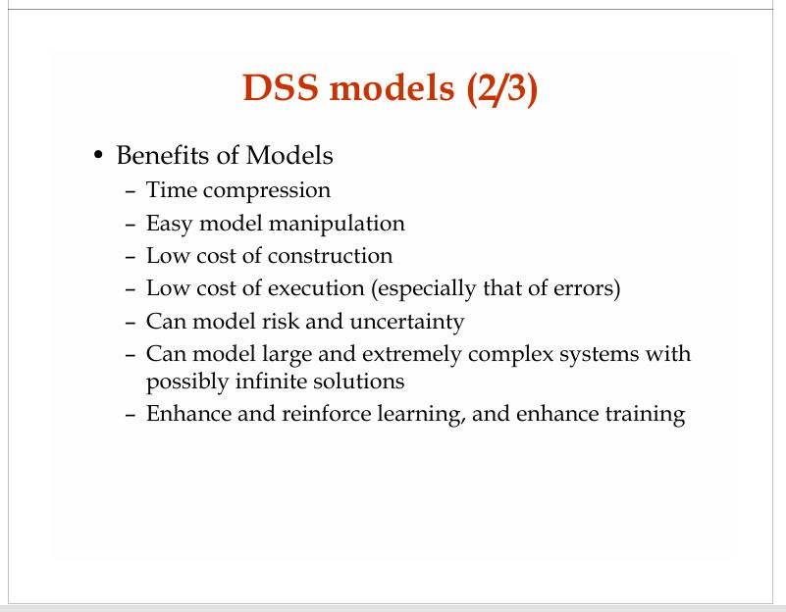

Slide 11
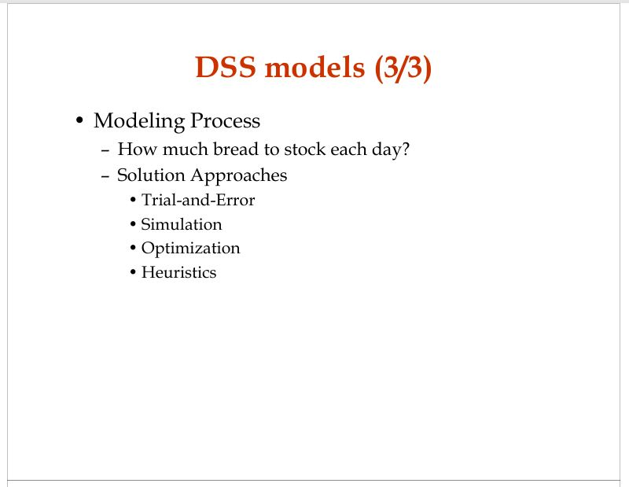

Slide 12
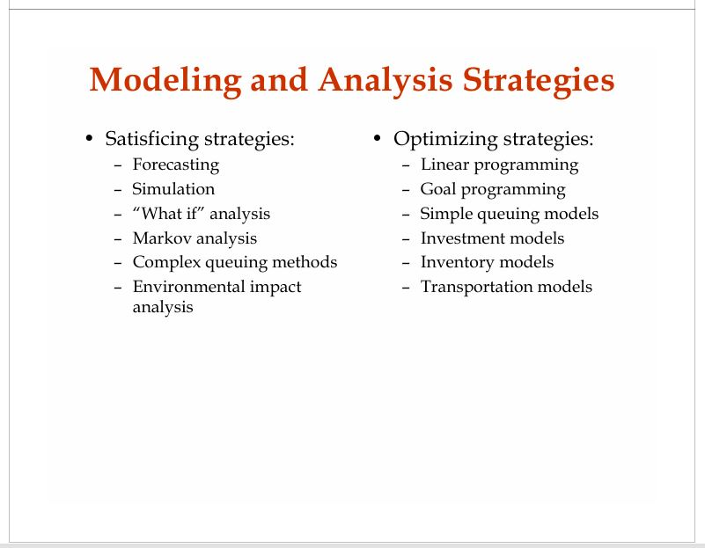

Slide 13
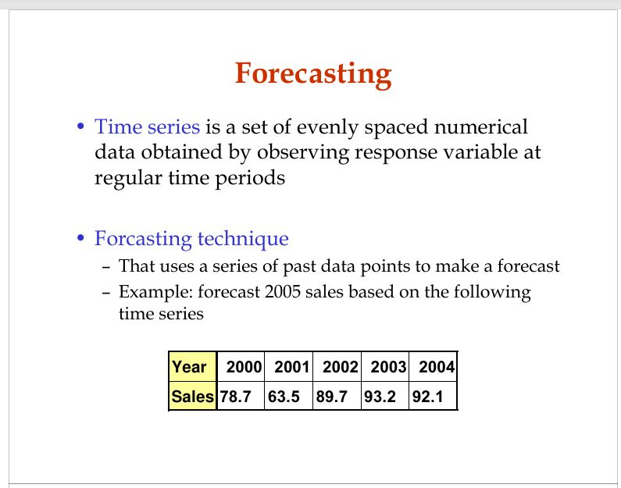

Slide 14
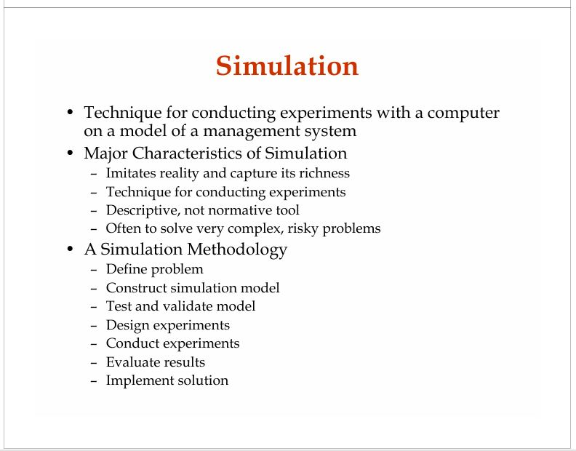

Slide 15
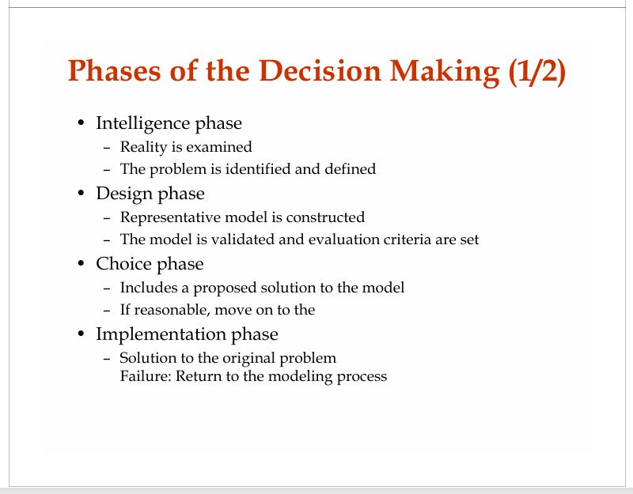

Slide 16
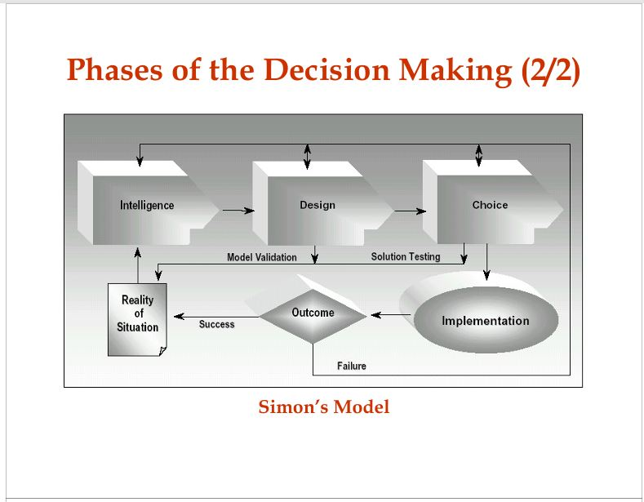

Slide 17
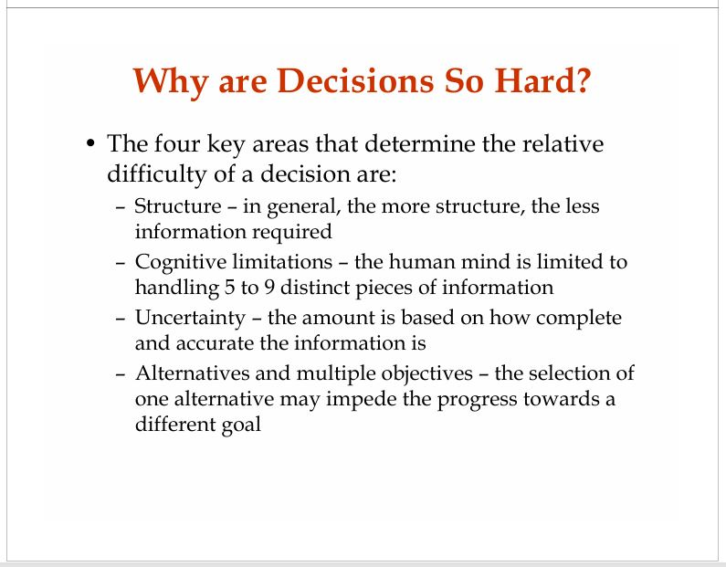

Slide 18
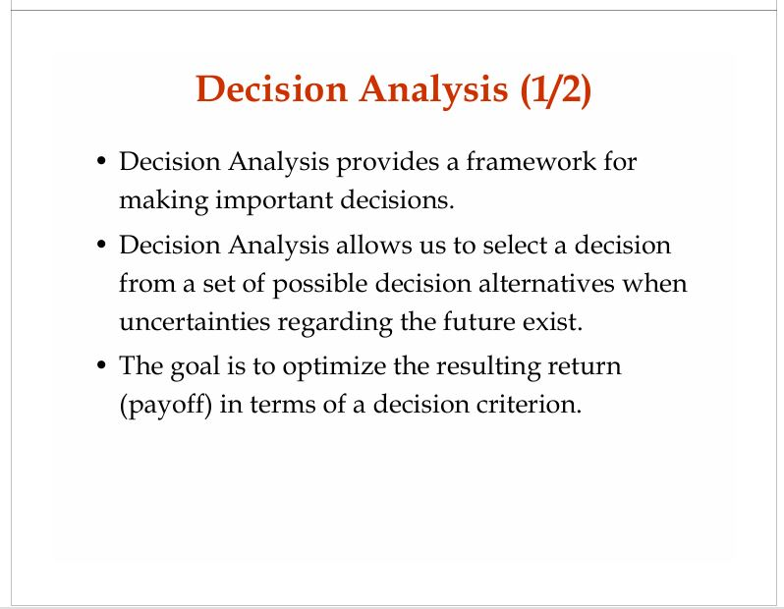

Slide 19
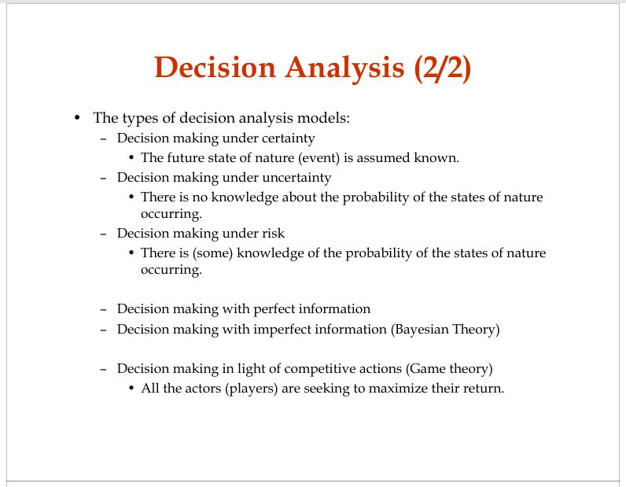

Slide 20
Changing Business Environment & Computerized Decision Support
Companies are moving aggressively to computerized support of their operations ⇨ Business Intelligence
Business Pressures–Responses–Support Model
  Business pressures result of today's competitive business climate
  Responses to counter the pressures
  Support to better facilitate the process

Slide 21
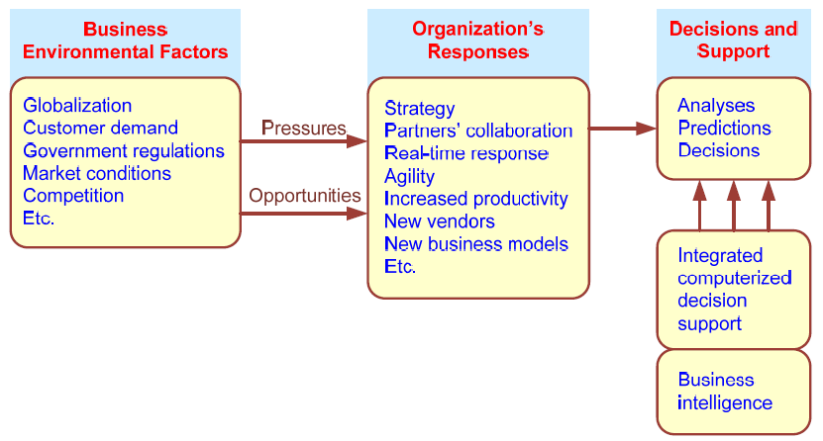
Business Pressures–Responses–Support Model

Slide 22
The Business Environment
The environment in which organizations operate today is becoming more and more complex, creating
  opportunities, and
  problems.
  Example: globalization.
Business environment factors:
  markets, consumer demands, technology, and societal…

Slide 23
Business Environment Factors
FACTOR DESCRIPTION
Markets Strong competition
Expanding global markets
Blooming electronic markets on the Internet
Innovative marketing methods
Opportunities for outsourcing with IT support
Need for real-time, on-demand transactions
Consumer Desire for customization
demand Desire for quality, diversity of products, and speed of delivery
Customers getting powerful and less loyal
Technology More innovations, new products, and new services
Increasing obsolescence rate
  Increasing information overload
Social networking, Web 2.0 and beyond
Societal Growing government regulations and deregulation
Workforce more diversified, older, and composed of more women Prime concerns of homeland security and terrorist attacks
Necessity of Sarbanes-Oxley Act and other reporting-related legislation Increasing social responsibility of companies
Greater emphasis on sustainability

Slide 24
Organizational Responses
Be Reactive, Anticipative, Adaptive, and Proactive
Managers may take actions, such as
  Employ strategic planning.
  Use new and innovative business models.
  Restructure business processes.
  Participate in business alliances.
  Improve corporate information systems.
  … more [in your book]

Slide 25
Closing the Strategy Gap
One of the major objectives of computerized decision support is to facilitate closing the gap between the current performance of an organization and its desired performance, as expressed in its mission, objectives, and goals, and the strategy to achieve them.

Slide 26
Managerial Decision Making
Management is a process by which organizational goals are achieved by using resources.
  Inputs: resources
  Output: attainment of goals
  Measure of success: outputs / inputs
Management ≅ Decision Making
Decision making: selecting the best solution from two or more alternatives

Slide 27
Decision-Making Process
Managers usually make decisions by following a four-step process (a.k.a. the scientific approach)
  Define the problem (or opportunity)
  Construct a model that describes the real-world problem.
  Identify possible solutions to the modeled problem and evaluate the solutions.
  Compare, choose, and recommend a potential solution to the problem.

Slide 28
Information Systems Support for Decision Making
Group communication and collaboration
Improved data management
Managing data warehouses and Big Data
Analytical support
Overcoming cognitive limits in processing and storing information
Knowledge management
Anywhere, anytime support

Slide 29
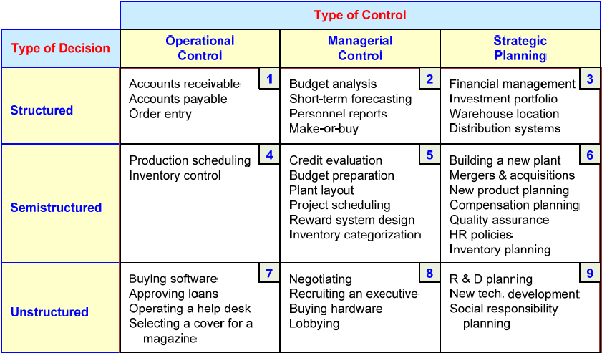
An Early Decision Support Framework (by Gory and Scott-Morten, 1971)

Slide 30
An Early Decision Support Framework
Degree of Structuredness (Simon, 1977)
  Decisions are classified as
    Highly structured (a.k.a. programmed)
    Semi-structured
    Highly unstructured (i.e., nonprogrammed)
Types of Control (Anthony, 1965)
  Strategic planning (top-level, long-range)
  Management control (tactical planning)
  Operational control

Slide 31
The Concept of DSS
DSS - interactive computer-based systems, which help decision makers utilize data and models to solve unstructured problems
(Gorry and Scott-Morton, 1971)
Decision support systems couple the intellectual resources of individuals with the capabilities of the computer to improve the quality of decisions.
DS as an Umbrella Term
Evolution of DS into Business Intelligence

Slide 32
A Framework for
Business Intelligence (BI)
BI is an evolution of decision support concepts over time
    Then: Executive Information System
    Now: Everybody’s Information System (BI)
BI systems are enhanced with additional visualizations, alerts, and performance measurement capabilities
The term BI emerged from industry

Slide 33
Definition of BI
BI is an umbrella term that combines architectures, tools, databases, analytical tools, applications, and methodologies
BI is a content-free expression, so it means different things to different people
BI's major objective is to enable easy access to data (and models) to provide business managers with the ability to conduct analysis
BI helps transform data, to information (and knowledge), to decisions, and finally to action

Slide 34
A Brief History of BI
The term BI was coined by the Gartner Group in the mid-1990s
However, the concept is much older
  1970s - MIS reporting - static/periodic reports
  1980s - Executive Information Systems (EIS)
  1990s - OLAP, dynamic, multidimensional, ad-hoc reporting -> coining of the term “BI”
  2010s - Inclusion of AI and Data/Text Mining capabilities; Web-based Portals/Dashboards, Big Data, Social Media, Analytics
  2020s - yet to be seen

Slide 35
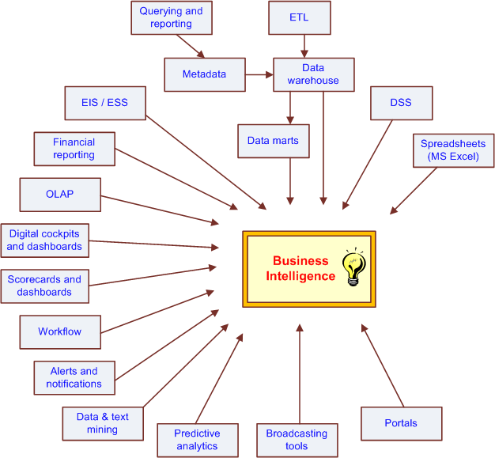
The Evolution of BI Capabilities

Slide 36
The Architecture of BI
A BI system has four major components
  a data warehouse, with its source data
  business analytics, a collection of tools for manipulating, mining, and analyzing the data in the data warehouse
  business performance management (BPM) for monitoring and analyzing performance
  a user interface (e.g., dashboard)

Slide 37
A High-Level Architecture of BI

Slide 38
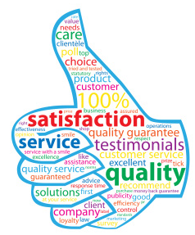
Business Value of BI Analytical Applications
Customer segmentation
Propensity to buy
Customer profitability
Fraud detection
Customer attrition
Channel optimization

Slide 39
Analytics Overview
Analytics?
  Something new or just a new name for …
A Simple Taxonomy of Analytics (proposed by INFORMS)
  Descriptive Analytics
  Predictive Analytics
  Prescriptive Analytics
Analytics or Data Science?

Slide 40
Analytics Overview

Slide 41
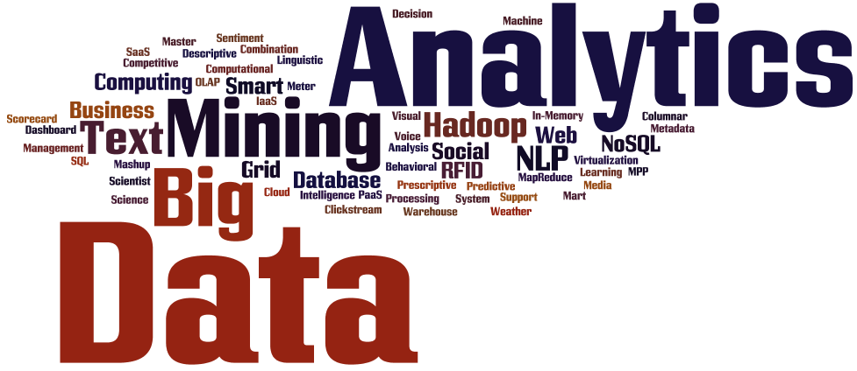
Introduction to Big Data Analytics
Big Data?
  Not just big!
  Volume
  Variety
  Velocity
More of Big Data and related analytics tools and techniques are covered in Chapter 13.

Slide 42
Thank you !!!

